Slide 1
Notification Central
Derek Greetan
Jessica Stein
Rachel Beal

Slide 2
Overview
Making a central window for computer notifications to simplify user’s experience
Notification 1
Notification 2
Notification 3
Notification 4
Other notifications

Slide 3
Main drivers
Easy to add too
Could be a cycle
Shows clear organization (tiers, steps, etc)
System is linear
Event driven

Slide 4
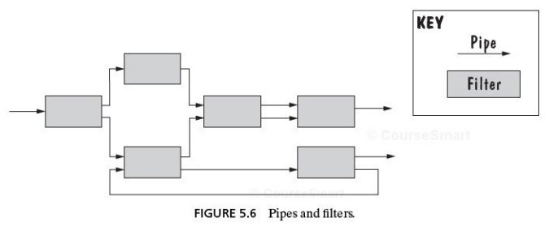
Architecture diagram option 1
Pipelining
Why:
Needs to be cyclical/continuous
show if/then relationships --- branching
easy to design
updatable in design b/c this is unchartered territory

Slide 5
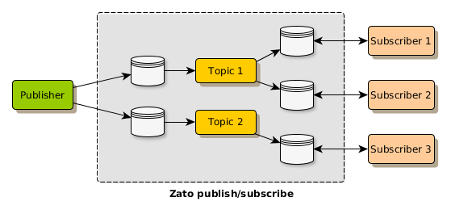
Architecture design option 2
Publish/subscribe
Why:
All about events—ties into notifications
Flow-chart
Shows how user interacts
If/then situations, ability to filter what happens next
Accounts for user customizing their area
Accounts for user using the application in real time

Slide 6
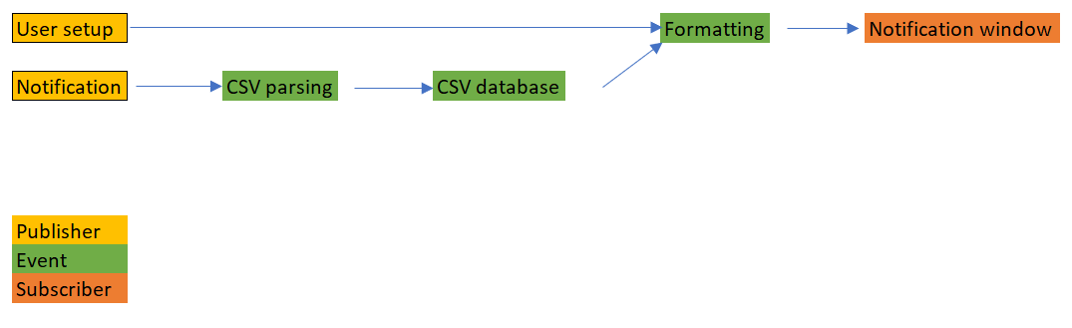
Publish/subscribe
Notes:
Our design is totally event driven

Slide 7
Conclusion
After considering all the options, publish/subscribe was selected to be the best – event driven, easy to understand

